Slide 1

CAPSTONE project: Predicting problem mortgage loans
Magali Solimano
december 2022

Slide 2
Table of contents
Problem Statement
Goal
Data Understanding
Results
Recommendations
Next Steps

Slide 3
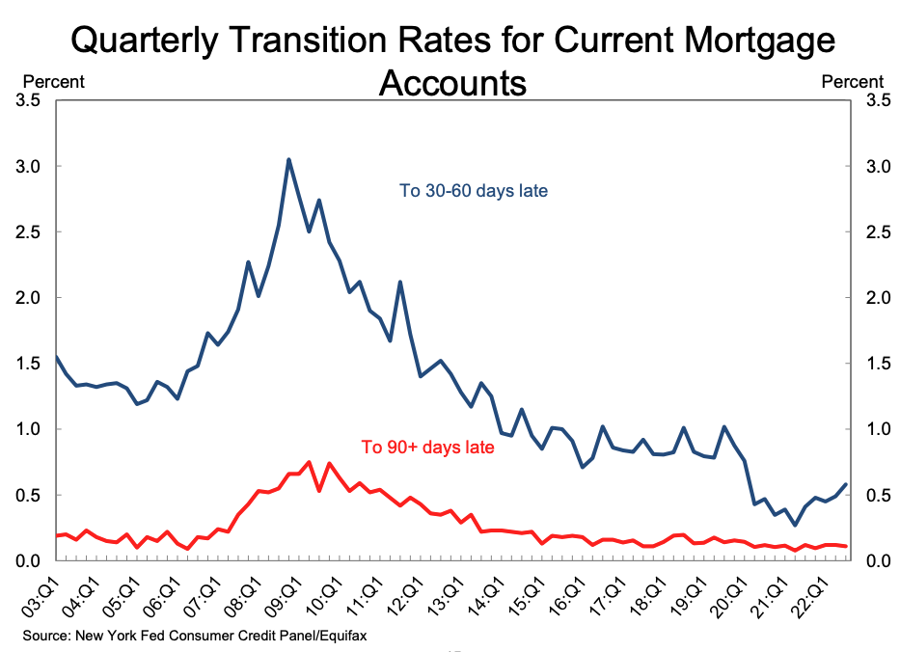
Problem statement
Fannie Mae wants to better predict the likelihood that a borrower will have problems paying its mortgage loan and to identify the features that best identify problem loans.
While mortgage loan delinquencies are currently very low, there are indications of potential increasing stress.

Slide 4
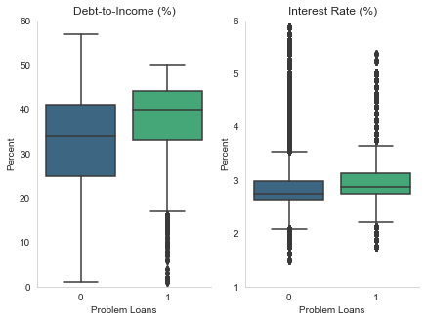
Goal
The goal is to predict the probability of problem loans and to identify their features in order to manage credit risk.

Slide 5
Data understanding
Data
- Fannie Mae Single Family Loan Data
Methods
- Descriptive data analysis and statistics
- Loans acquired in Q1 2021
- Over 23 million records
- Machine learning modelling

Slide 6
DATA UNDERSTANDING
Definitions
Problem loans
payments that are 90 or more days past due
have been modified, restructured, or received any borrower assistance
have been foreclosed
Binary classification
non-problem, performing loans are classified as ‘0'
problem loans are classified as ‘1’

Slide 7
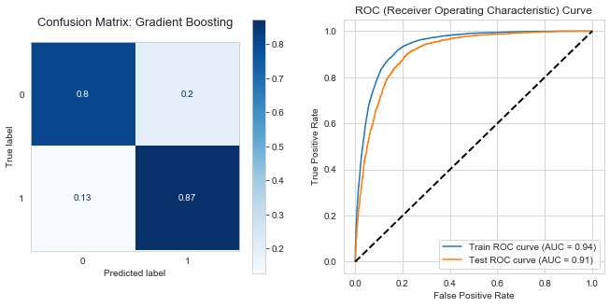
results
Gradient Boosting model selected as best performing model
True positive rate of 87%
Low false positive
Low false negative

Slide 8
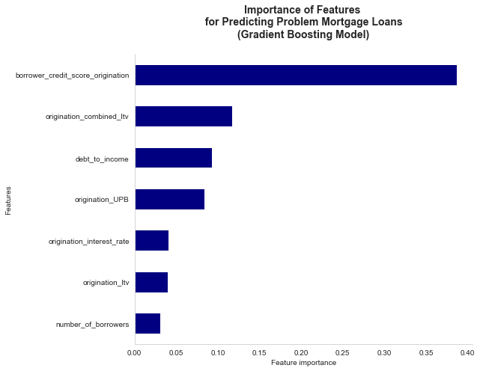
results
Top features represent metrics that are commonly used in credit risk assessments

Slide 9
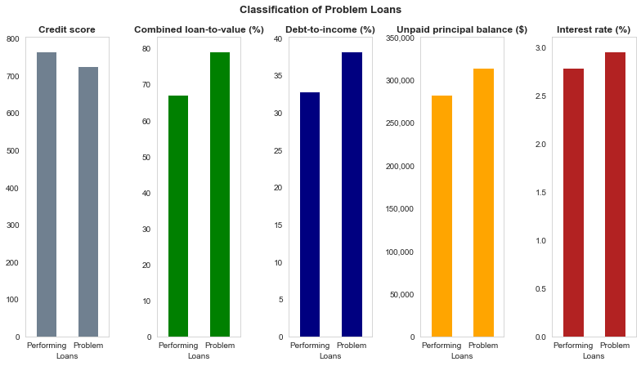
recommendations
Adjust the criteria Fannie Mae applies to the loans they acquire and guarantee
Focus credit risk management resources on loans that are likely to be problem loans

Slide 10
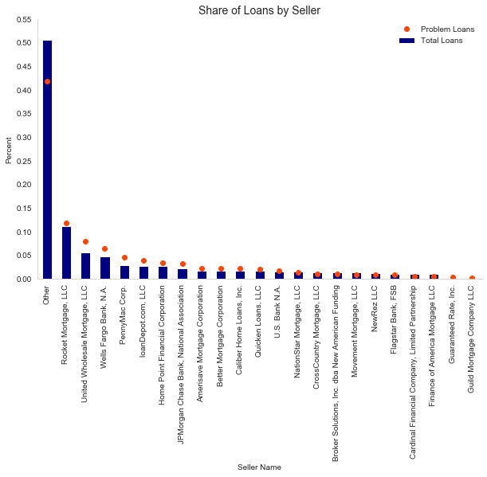
recommendations
Mortgage loans sold by some sellers should be examined more closely for problem loans compared to other sellers

Slide 11
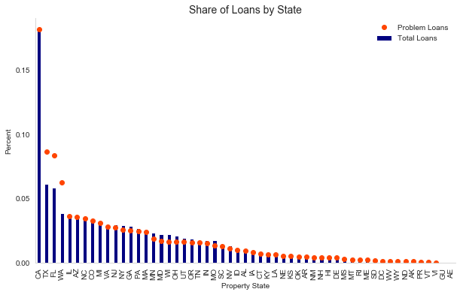
recommendations
Mortgage loans for properties in certain states should also be examined more closely for problem loans compared to other states

Slide 12



NEXT STEPS: extended analysis
Improve model performance
Predict value of losses for problem loans
Extend geographical analysis to zipcode level

Slide 13
Thank you
For questions, contact:
Magali Solimano
magali.solimano@gmail.com

